Slide 1

AWS Snow Family

Slide 2
The AWS Snow Family is a suite of physical devices designed by Amazon Web Services (AWS) to enable secure and efficient data migration, edge computing, and data storage in environments with limited or no internet connectivity. These devices are particularly useful for organizations needing to transfer large volumes of data to and from the AWS Cloud or run compute workloads in remote or rugged locations.
Key Members of the Snow Family
1. AWS Snowcone
2. AWS Snowball
3. AWS Snowmobile

Slide 3
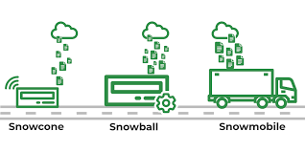

Slide 4
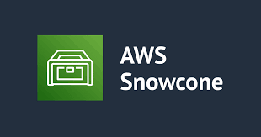
1. AWS Snowcone
The smallest and most portable device in the Snow Family, designed for lightweight data transfer and edge computing.
Specifications:
Storage: 8 TB of usable storage.
Weight: 4.5 pounds (2.1 kg).
Rugged, portable, and secure.
Use Cases:
Small-scale data transfer to AWS.
Running edge computing workloads in remote locations using AWS IoT Greengrass.
Collecting and pre-processing data on the go.
Connectivity: Can transfer data via Wi-Fi or wired connections.

Slide 5

2. AWS Snowball
A mid-sized device available in two configurations: Snowball Edge Storage Optimized and Snowball Edge Compute Optimized.
Configurations:
Storage Optimized:
Usable storage: Up to 80 TB.
Ideal for bulk data transfer and local storage.
Compute Optimized:
Usable storage: Up to 42 TB.
Includes compute capabilities with optional GPU support for machine learning, analytics, or image processing.
Features:
Built-in encryption for secure data transfer.
Supports running applications at the edge using AWS services like IoT Greengrass or EC2 instances.
Use Cases:
Large-scale data migration to AWS.
Edge computing in remote locations.
Disaster recovery and business continuity.
Connectivity: Data transfer via network or external storage devices.

Slide 6
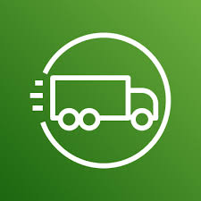
3. AWS Snowmobile
A massive-scale data migration service, essentially a secure shipping container designed for petabyte to exabyte-level data transfer.
Specifications:
Capacity: Up to 100 PB per Snowmobile.
Physical Size: 45-foot ruggedized shipping container.
Transported via a dedicated truck.
Use Cases:
Large-scale migrations of on-premises data centers to AWS.
Archiving massive datasets like genomic data, video libraries, or satellite imagery.
Security:
Multi-layered security with encryption and GPS tracking.
Escorted by AWS personnel during transit.

Slide 7
Common Features Across the Snow Family
1. Data Encryption:
All data is encrypted using 256-bit encryption.
Encryption keys are managed by AWS Key Management Service (KMS).
2. Rugged and Portable:
Designed to withstand harsh environments, making them suitable for remote or industrial sites.
3. Data Transfer Automation:
Simplified transfer process using AWS DataSync or Snow-specific tools.
4. Tamper-Proof Design:
Devices are physically secure and equipped with anti-tamper mechanisms.
5. Integrated with AWS Services:
After data transfer, the devices upload data directly to AWS S3, Glacier, or other storage services.

Slide 8
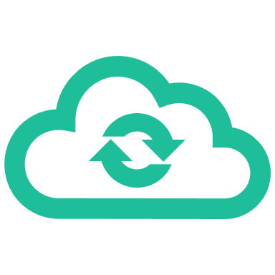
Use Cases for the AWS Snow Family
1. Data Migration:
Move petabyte-scale datasets to the cloud efficiently.
2. Edge Computing:
Run applications locally in environments with limited or no connectivity.
3. Disaster Recovery:
Store critical backups for recovery in case of emergencies.
4. Media and Entertainment:
Transfer high-resolution video files for production or streaming workflows.
5. Scientific Research:
Process and migrate large datasets from remote research stations, such as weather or genomic data.

Slide 9
Benefits of the Snow Family
Cost-Effective: Reduces high bandwidth costs for large-scale data transfers.
Secure: Uses advanced encryption and physical security mechanisms.
Scalable: Offers options for small, medium, and massive data transfer needs.
Efficient: Transfers data faster than over typical internet connections.
Reliable: Designed for challenging environments and reliable operation.

Slide 10
Comparison of Snow Family Devices
Feature | Snowcone | Snowball Edge (Storage/Compute) | Snowmobile
Capacity | 8 TB | 42 TB - 80 TB | Up to 100 PB
Portability | Highly portable | Moderate portability | Not portable
Compute Capabilities | Limited (via IoT Greengrass) | Advanced (EC2, ML, GPU options) | Not applicable
Use Case | Small data transfers | Large data migrations, edge workloads | Massive-scale migrations
Physical Size | Small, lightweight | Rugged suitcase-sized device | 45-foot container

